Slide 1

Word-based Language Identification Pipeline

Slide 2
Purpose
examine the components of the previously created pipeline
explore the pipeline’s capabilities using large and high quality test samples

Slide 3
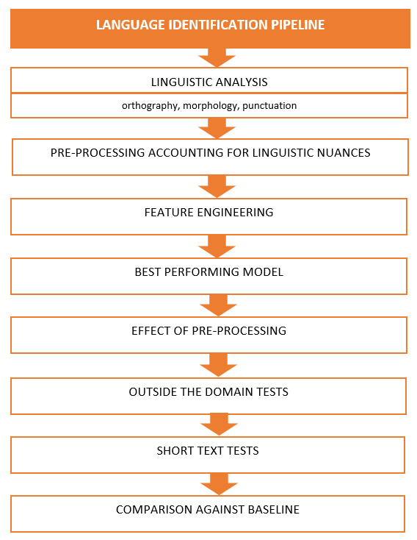
Overview of the Pipeline’s Structure

Slide 4
Outside the Domain Data
FORMAL
INFORMAL
LONG TEXT
SHORT TEXT
with few stop words
LONG TEXT
SHORT TEXT
reduced number of stop words

Slide 5
Pre-processing preserving linguistic characteristics
1. Linguistic analysis
2. Pre-processing while accounting for unique linguistic features:
no stemming
preserving unique stop words
preserving unique punctuation

Slide 6
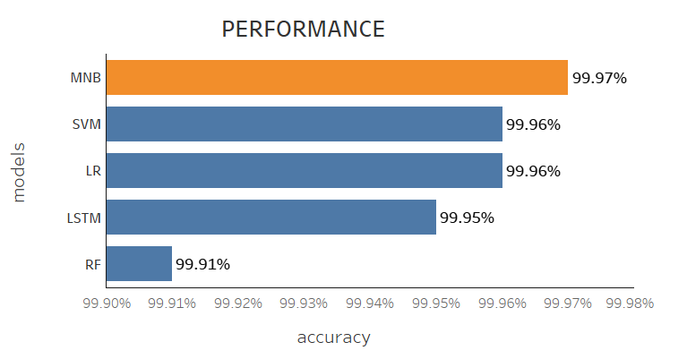
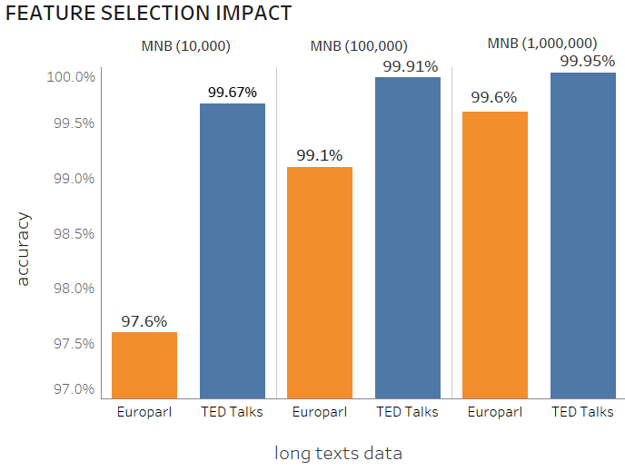
Multinomial Naïve Bayes

Slide 7
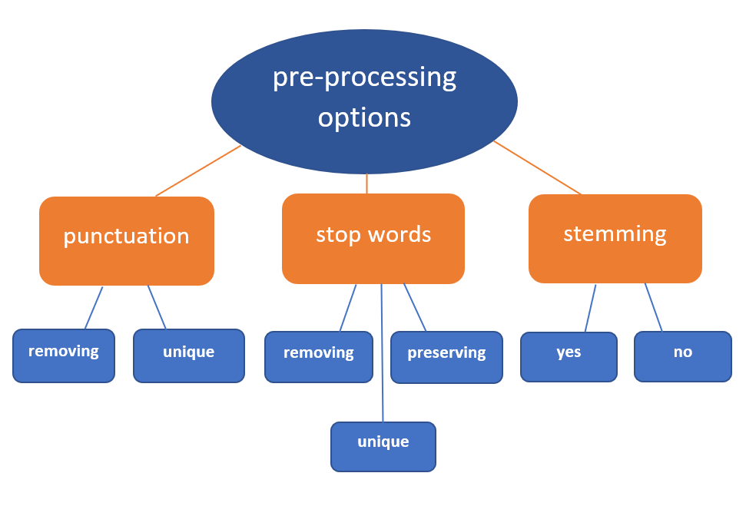
Experiments. Pre-processing options
To understand the impact of the pre-processing techniques we test various pre-processing options

Slide 8
Effect of pre-processing options and CountVectorizer
Technique | Test set | Formal (long) | Formal (short) | Informal (long) | Informal (short)
unique linguistic features* | 99.995% | 99.953% | 97.6% | 99.6% | 99.0%
no punctuation | 99.995% | 99.951% | 97.6% | 99.6% | 99.0%
stemming | 99.555% | 99.6% | 68% | 97.1% | 78.5%
preserving all stop words | 99.990% | 99.953% | 97.6% | 99.6% | 98.9%
Removing stop words | 97.98% | 81.5% | 91.2% | 73% | 89.5%
CountVectorizer | 99.995% | 99.96% | 97.8% | 99.6% | 99.1%
* Pre-processing with unique linguistic features includes no stemming, preserving unique punctuation and unique stop words and TF-IDF as a feature selection method

Slide 9
Comparison of Feature Engineering Techniques
CountVectorizer
TF-IDF
VS

Slide 10
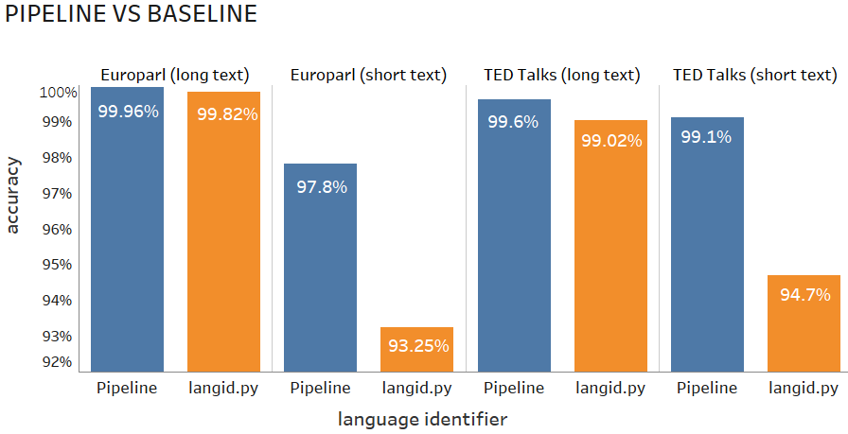
Comparison against the Baseline

Slide 11
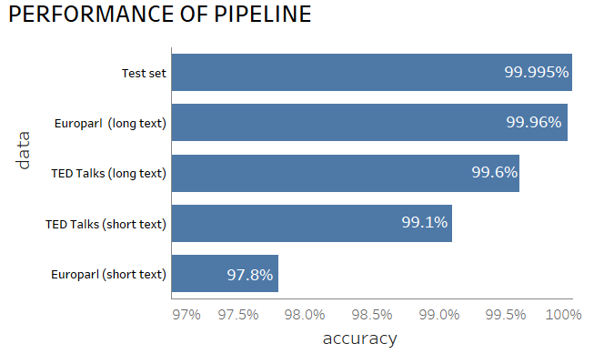
Results and Conclusion

Slide 12
Recommendations
experimenting with different types of word n-grams
increasing the pool of languages
Thank you!

